Slide 1
Raid Storage
Week 13

Slide 2
RAID
RAID – or Redundant Array of Independent Disks – is a type of storage that writes data across multiple drives within the same system.
Different configurations are expressed as numbers, such as RAID 0, RAID 1, or RAID 5.
Each RAID type gives users different benefits:
— increased performance,
— greater fault tolerance, or a combination of both
— depending on how it writes and distributes your data.

Slide 3
Why Need RAID?
Maintain maximum uptime and availability on your system
Work with large files without slowing down operations
Have data redundancy to protect important information
Increase the potential mean time to failure of your system

Slide 4
RAID vs Data Backup
RAID:
make your data storage more powerful and resilient
RAID arrays spread I/O operations across multiple disks in order to read and write data faster
BACKUP:
data backup helps you restore lost files

Slide 5
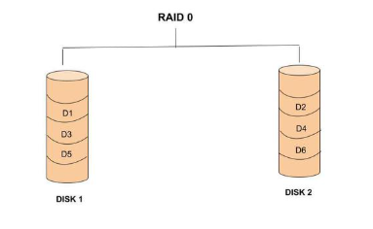
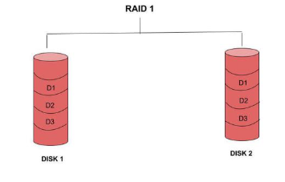
Key Concepts in RAID
Striping:
Data split into blocks and distributed across disks (RAID 0). Enhances performance.
Mirroring:
Duplicate data on two or more disks (RAID 1). Ensures redundancy
Parity:
Calculated data used to rebuild lost information (RAID 5/6). XOR operations for single parity (RAID 5), dual parity for RAID 6.

Slide 6
Parity Function in RAID
The parity function is a mathematical operation (typically XOR - Exclusive OR) applied to data blocks across multiple disks to generate a parity block. This parity block is used to reconstruct lost data in case of a disk failure.

Slide 7
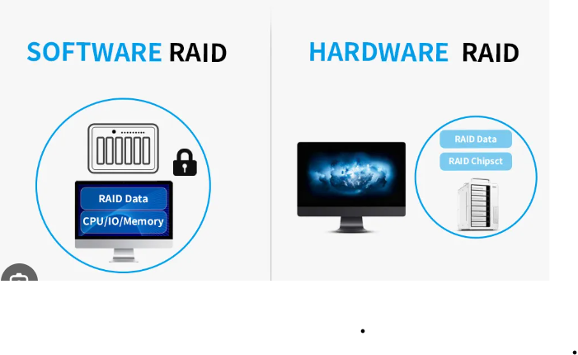
Implementation of RAID

Slide 8
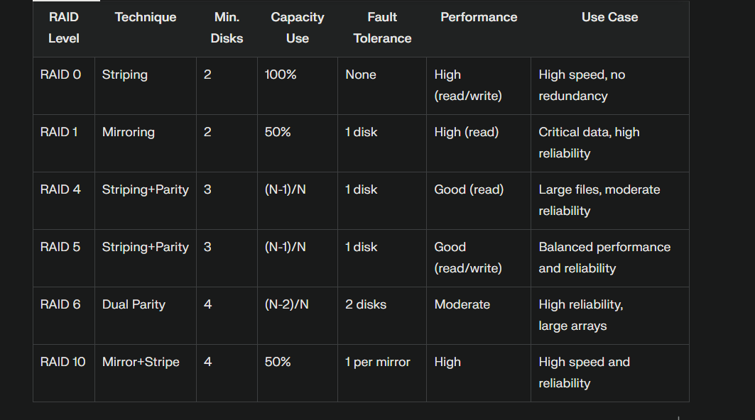
RAID Levels
Different configurations balancing speed, capacity, and reliability.

